Slide 1
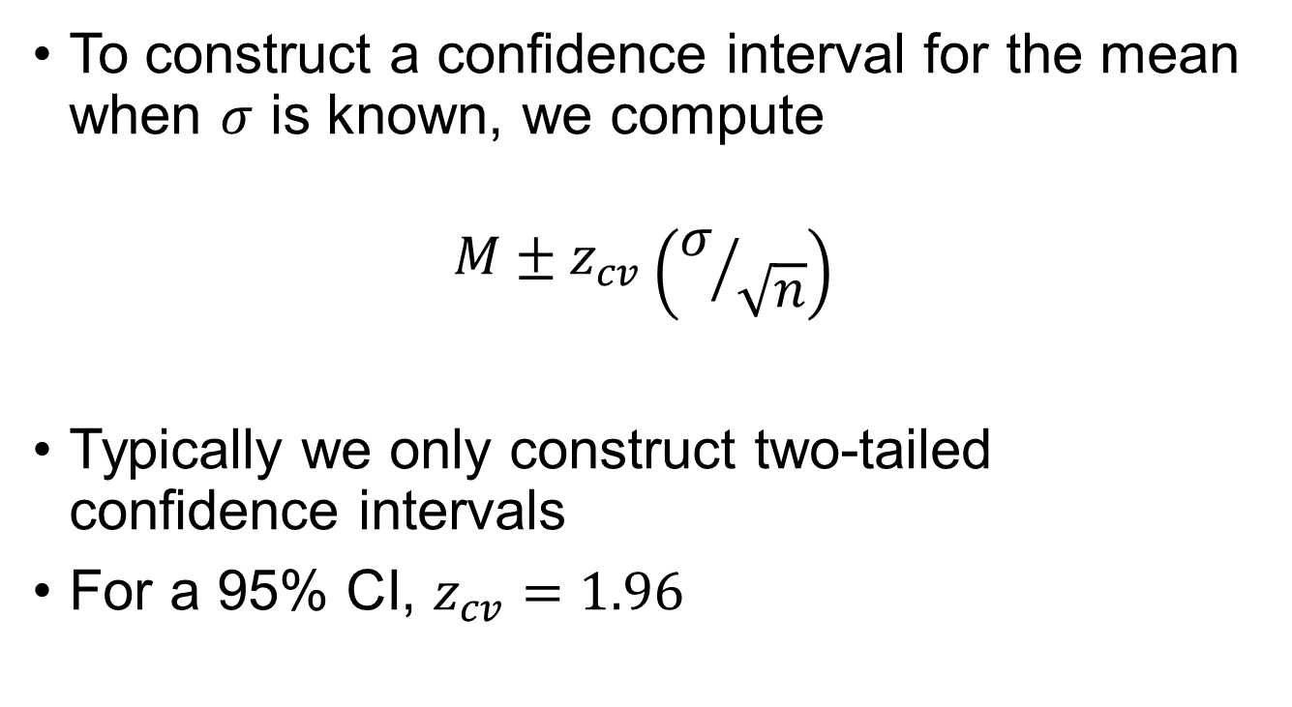
One-Sample z-test
To construct a confidence interval for the mean when $σ$ is known, we compute
$$M±z_{cv}\left(σ/{\sqrt{n}}\right)$$
Typically we only construct two-tailed confidence intervals
For a 95% CI, $z_{cv}=1.96$

Slide 2
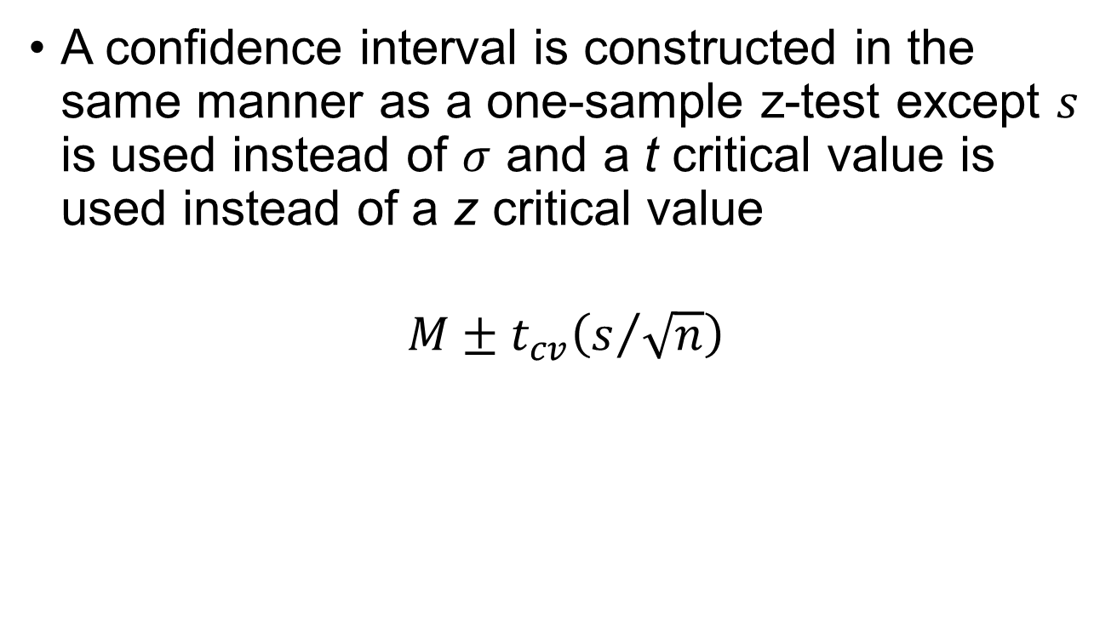
One-Sample t-test
A confidence interval is constructed in the same manner as a one-sample z-test except $s$ is used instead of $σ$ and a t critical value is used instead of a z critical value
$$M±t_{cv}\left(s/{\sqrt{n}}\right)$$

Slide 3
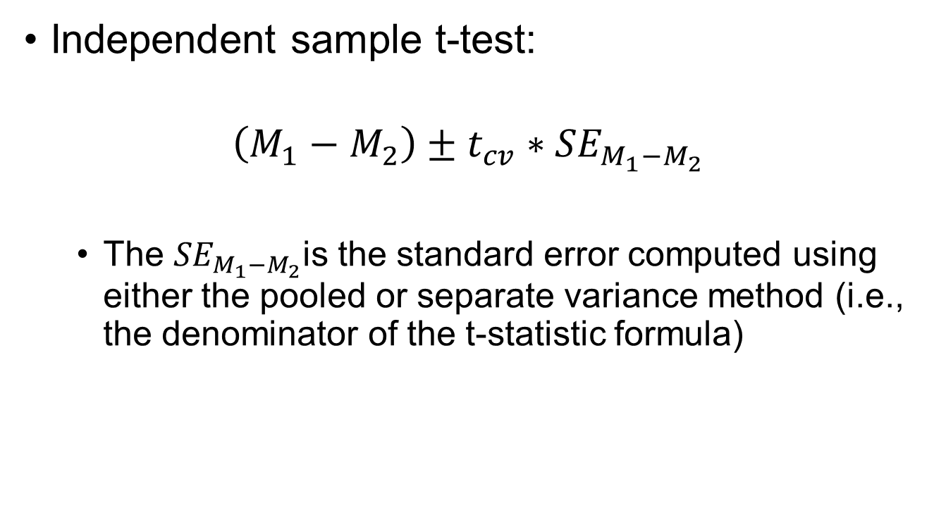
Independent-Samples t-test
Independent sample t-test:
$$\left(M_{1}−M_{2}\right)±t_{cv}∗{SE}_{M_{1}−M_{2}}$$
The ${SE}_{M_{1}−M_{2}}$is the standard error computed using either the pooled or separate variance method (i.e., the denominator of the t-statistic formula)

Slide 4

Related-Samples t-test
Related-samples t-test
$$\overline{D}±t_{cv}\left({S_{D}}/{\sqrt{n}}\right)$$

